Slide 1
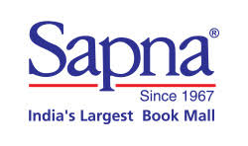
They want to build the book recommendation engine which converts the Shoppers to Customers. They want the recommendation engine to show their customers that they are valued as an individual by showing the options that meet his/her interest.

Slide 2

I carried out the following Data Science Process .
Data Collection
Data Cleaning & EDA
Data Visualization
Content Based Recommendation
Item-Item Based Recommendation
Truncated SVD algorithm
Conclusion and Improvements needed.

Slide 3
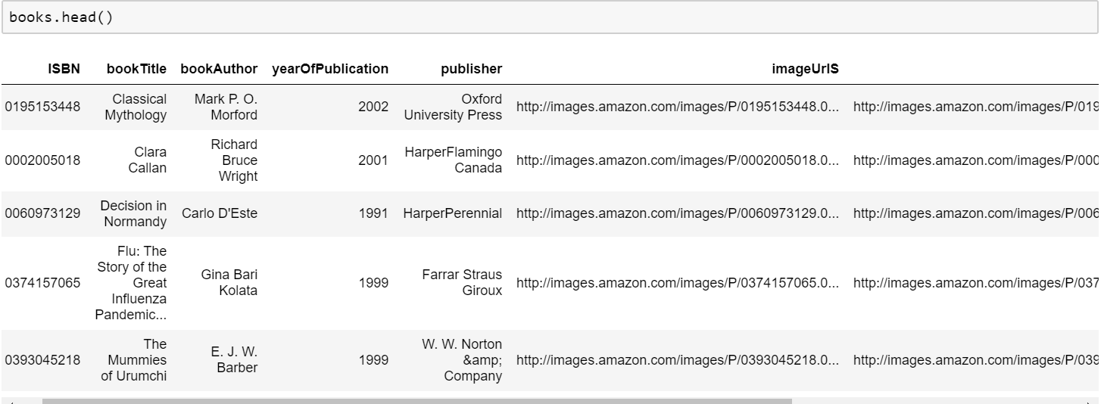
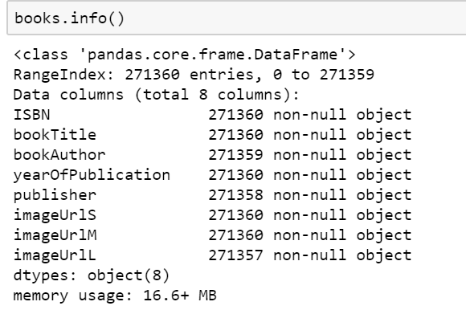
Books Dataset

Slide 4
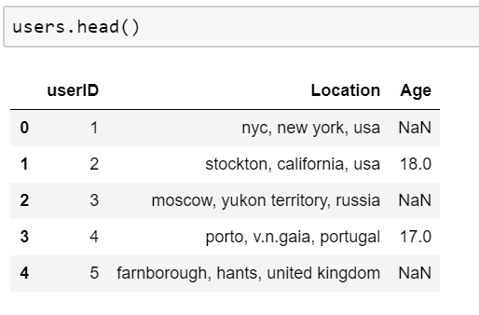
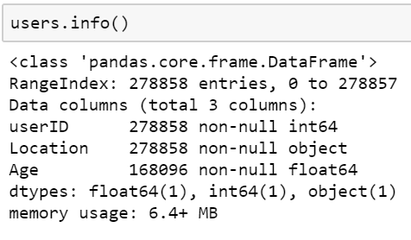
Users Dataset

Slide 5
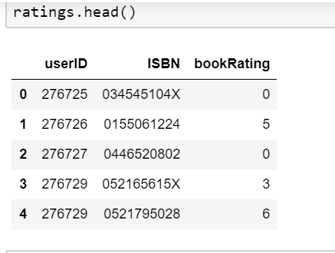
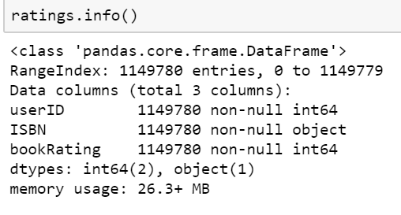
Ratings Dataset

Slide 6
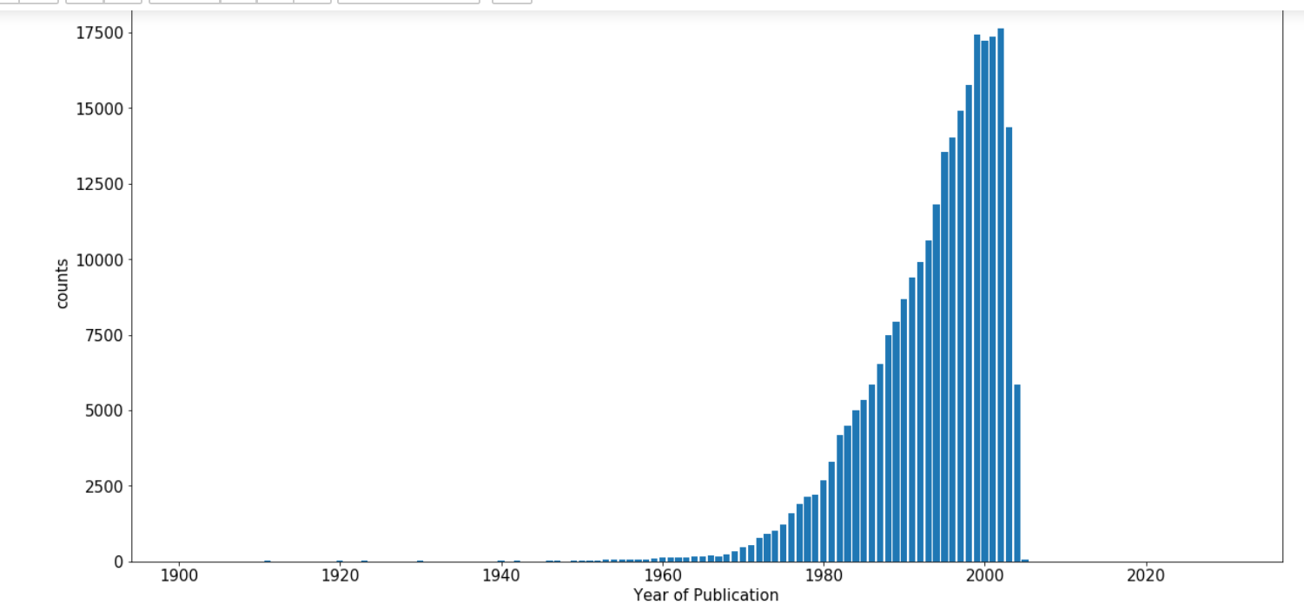
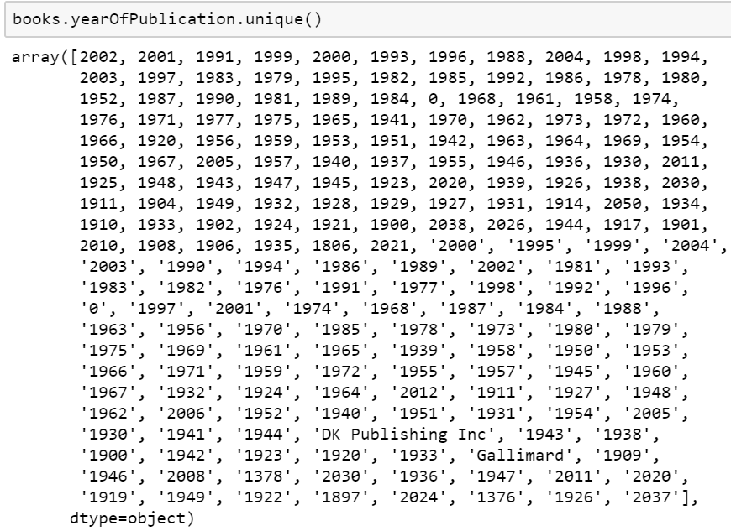
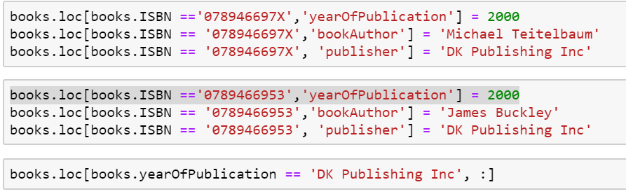
Data Cleaning
Books Dataset : Year Of Publication

Slide 7
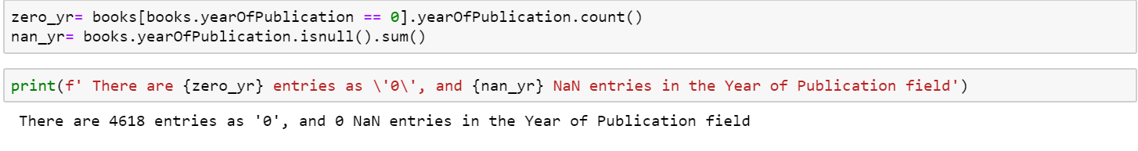
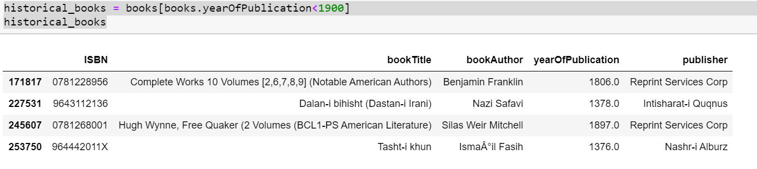

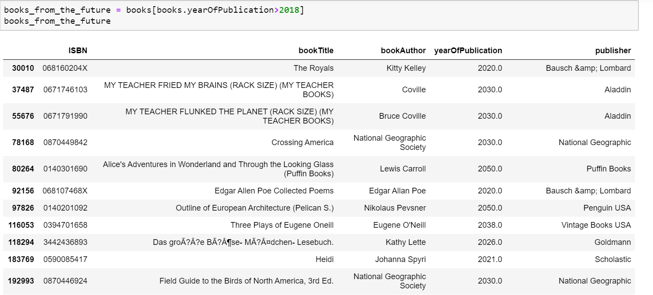
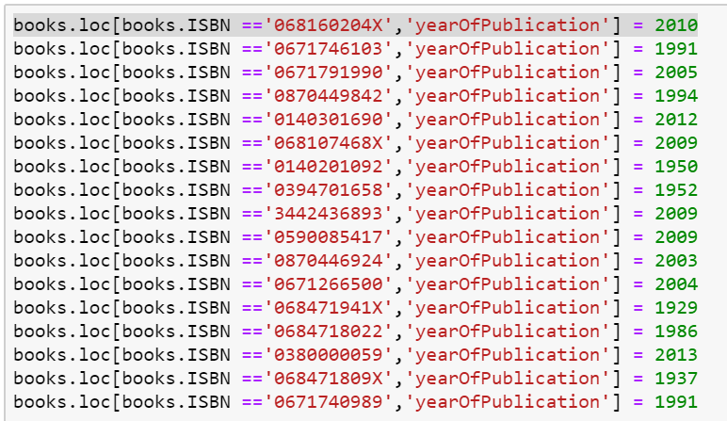

Slide 8
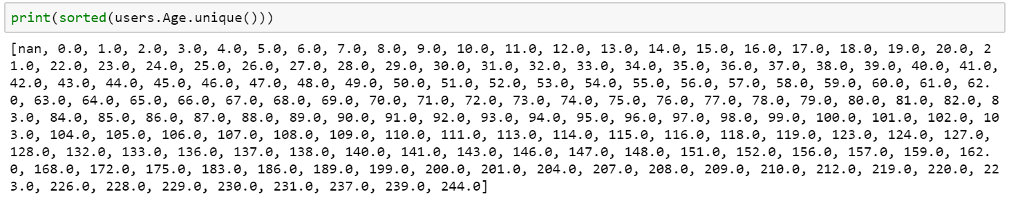
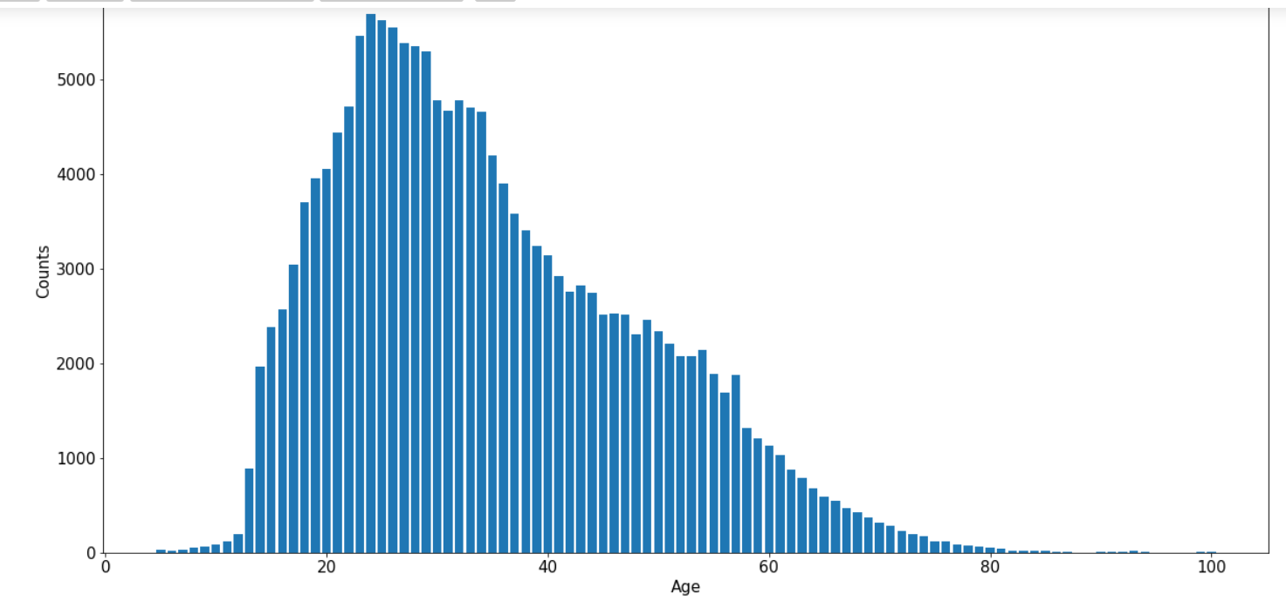
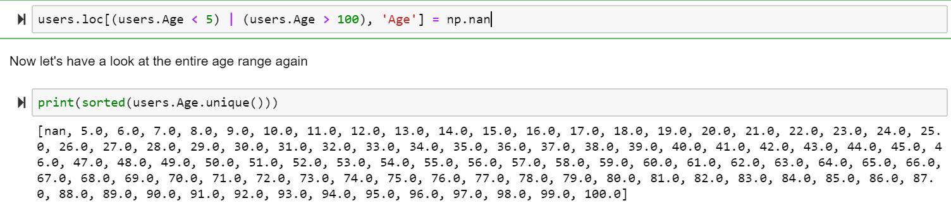
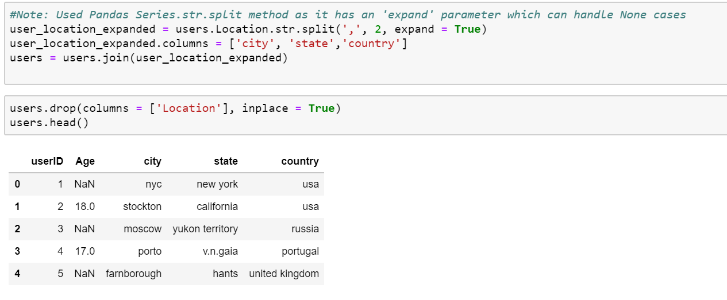
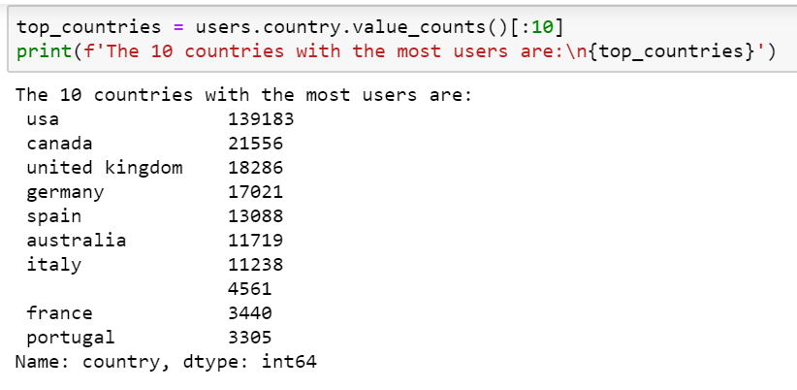
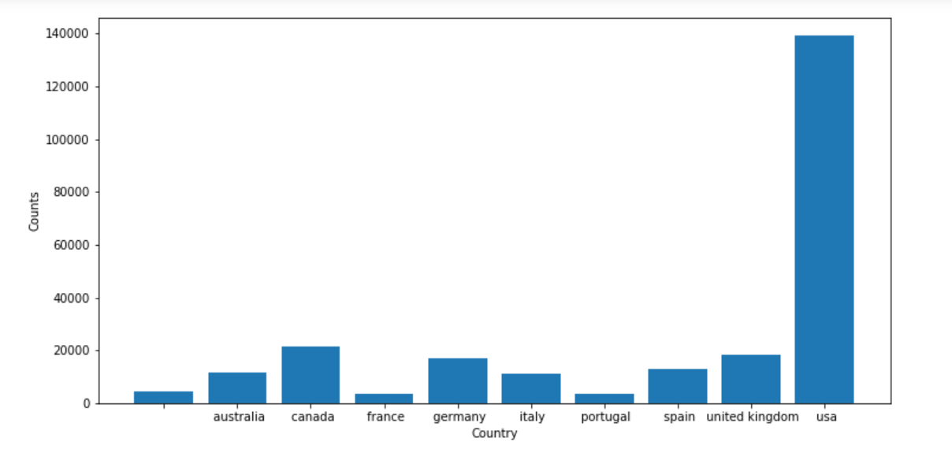
Users Dataset : Age
Users : Location

Slide 9
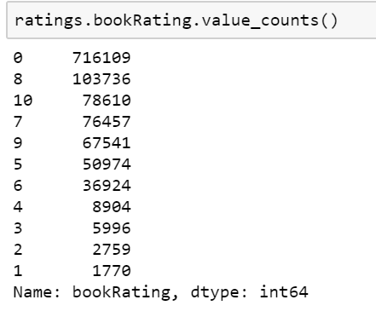
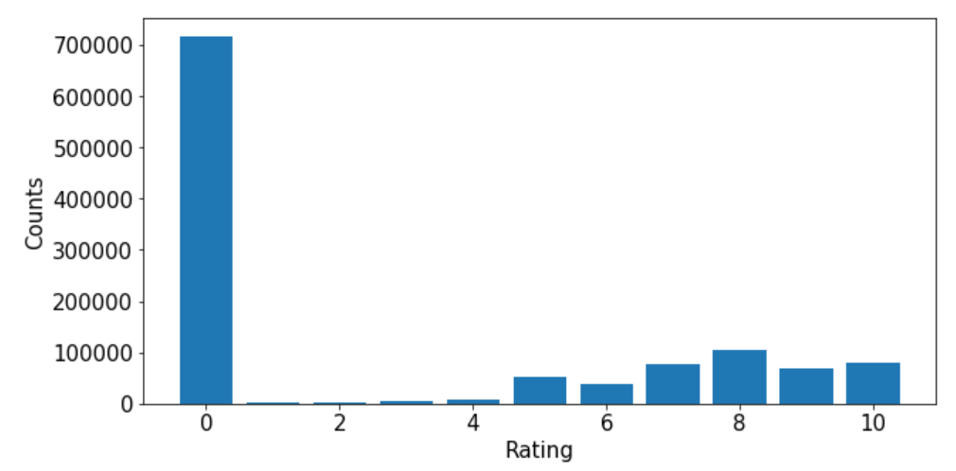
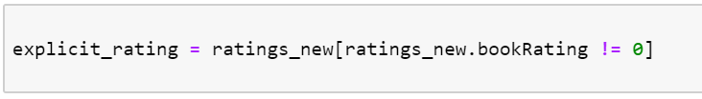
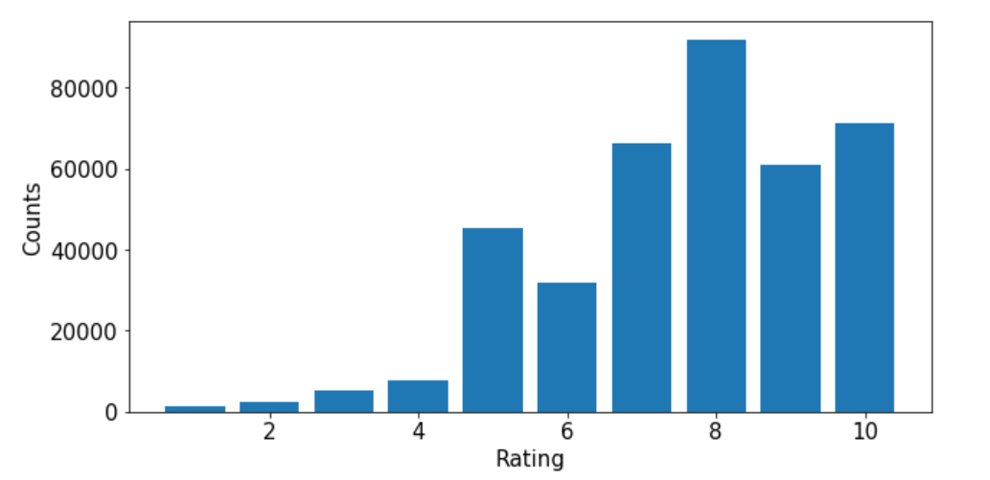
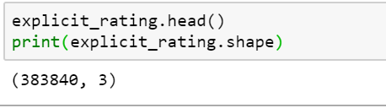


Slide 10
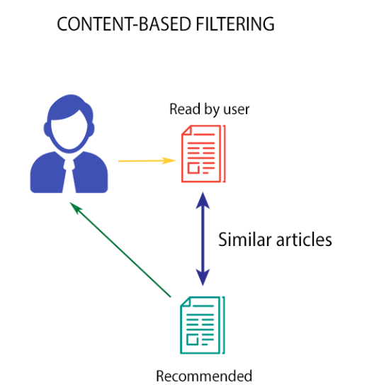
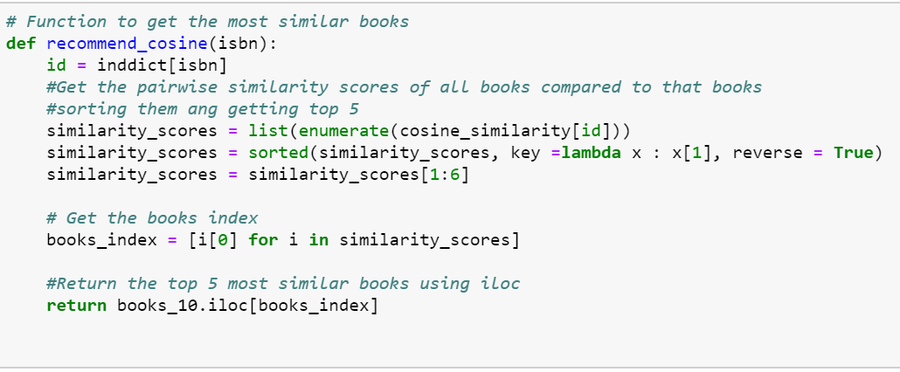
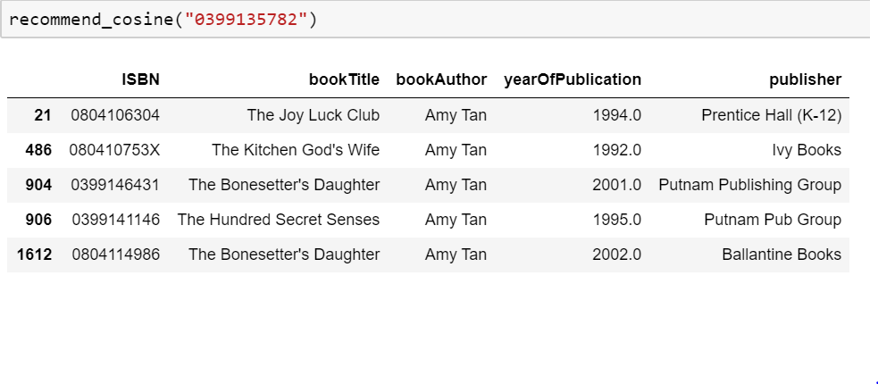
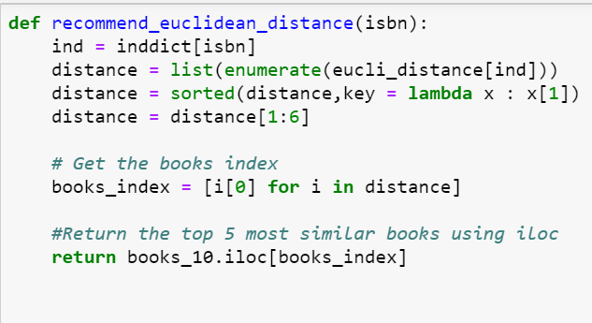
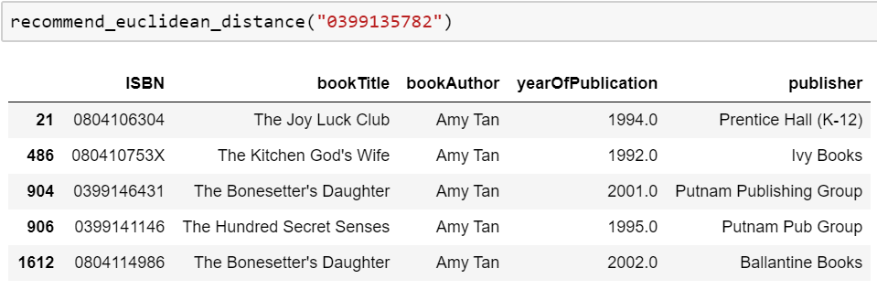
Content Based Filtering(Book_Author)

Slide 11
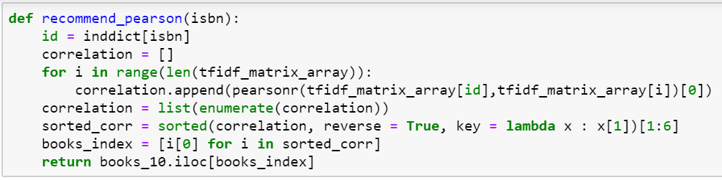
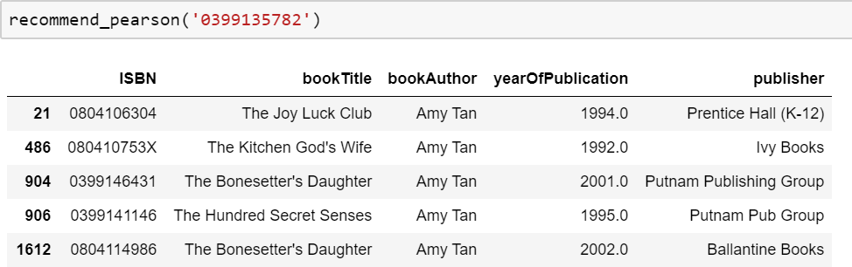
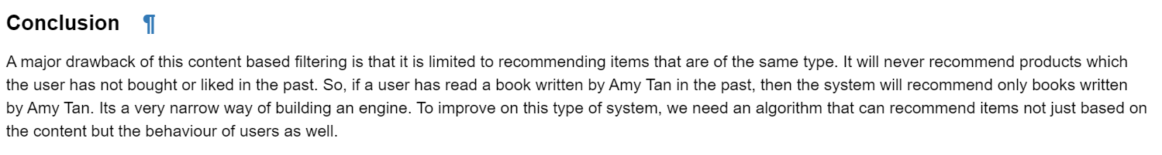
Content Based Filtering(Book_Author)

Slide 12
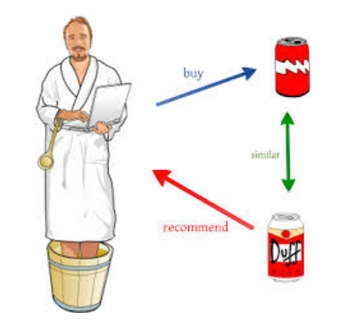
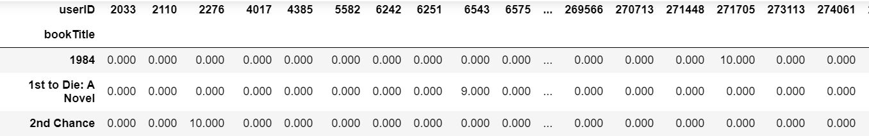
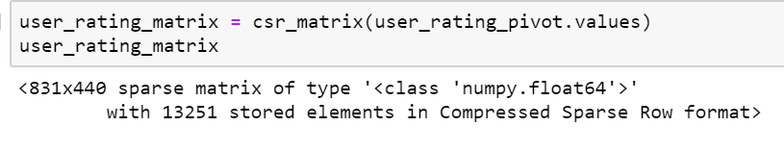
Item-Item Based Collaborative Filtering
Pivot Ratings into User-Rating
To have better interpretation of the data, we pivot the data frame to have book_title as rows and user_id as columns, filling the null values with 0.0 . The matrix should look something like this.
Transform the values(book_rating) of the matrix data frame into a scipy sparse matrix for more efficient calculations

Slide 13
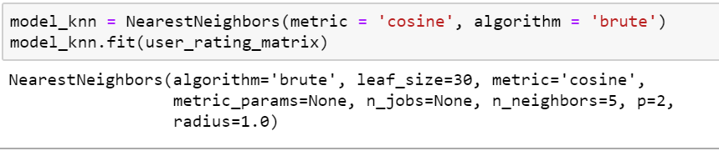
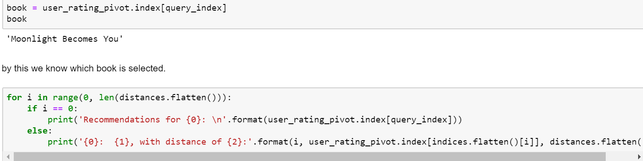
To implement item-based collaborative filtering:
K-NN is a perfect choice and also very good baseline for recommender system.
It uses a database in which the data points are separated into several clusters to make inference for new samples.
For high dimension space, we use cosine similarity for nearest neighbour search.
Since we have huge number of records, let us go by taking any random book and based on the rating, we will get recommendations.

Slide 14
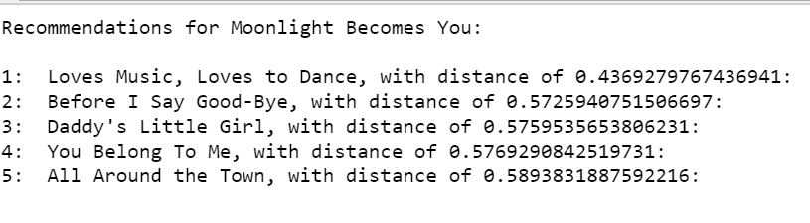
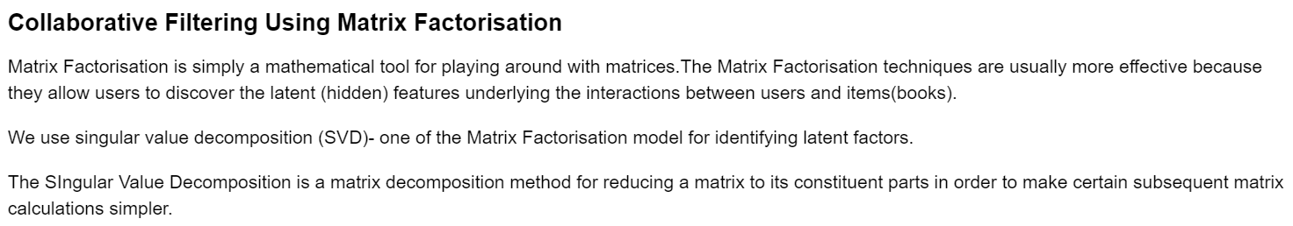
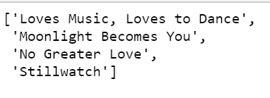
When I compared Moonlight Becomes you with all the books recommended, I can see the similarity among it.
All the books are Suspense, Fictional , Mystery and Thriller books
All the books are Suspense, Fictional , Mystery and Thriller books

Slide 15
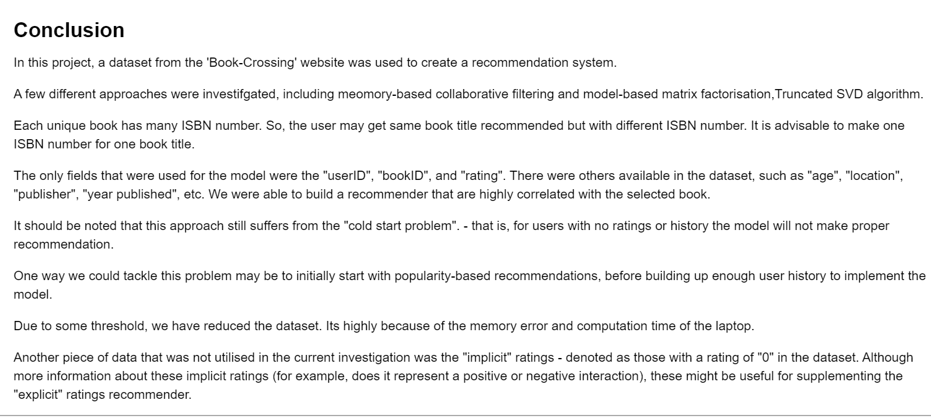
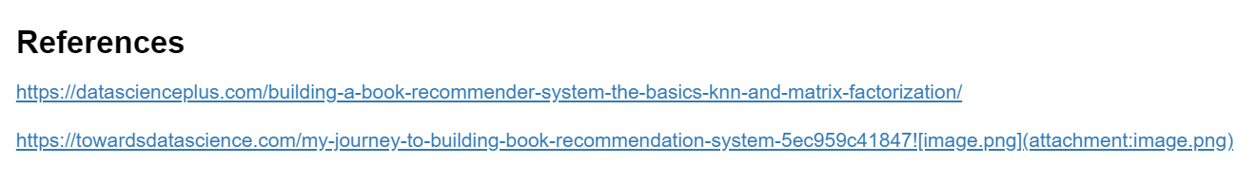

Slide 16
Hope, Sapna Book House likes my recommendation which is built for them.
Thank you

